Slide 1
Chapter 2: Multithreading in Java Programming
Debir Birhan University
Chapter 2. Multithreading in Java programming
∅ Introduction to multithreading, Thread States: Life Cycle of
a Thread, Thread priority and thread scheduling, Creating
and executing threads, Thread synchronization, Producer
/Consumer relationship without synchronization, Producer
/Consumer relationship with synchronization. Producer
/Consumer relationship: Circular Buffer, Daemon Threads,
Runnable Interfaces, synchronous and asynchronous call
∅ Lab Content: Implement multithreading
CLO2: Describe multithreading and asynchronous programming concepts
CLO3: Develop a solution for a given problem using multithreaded and asynchronous
Prepared By:-Zerihun T

Slide 2
Chapter 2: Multithreading in Java Programming
Outlines
1. Introduction to Multithreading
1.1. Concept of processes vs. threads
1.2. Thread lifecycle: New, Runnable, Blocked, Waiting, Terminated
1.3. Thread creation: Extending Thread class or implementing Runnable interface
1.4. Thread scheduling and priorities
2. Thread Synchronization
2.1. Why synchronization is necessary
2.2. Using the synchronized keyword to prevent race conditions
2.3. Deadlocks and how to avoid them
3. Producer-Consumer Problem
3.1. Using wait(), notify(), and notifyAll() methods
3.2. Implementing a bounded buffer using synchronization

Slide 3
Introduction to Multithreading
1.What is Multithreading?
Multithreading is the ability of a CPU, or a single core in a multi-core processor, to provide multiple threads of execution concurrently.
A thread is the smallest unit of a process that can be scheduled for execution.
1.1. Concept of processes vs. threads
Process:
A process can be thought of as a program in execution
A program in execution; may contain multiple threads.
Thread:
A thread is the unit of execution within
A single sequence of execution within a process.
Process
Thread
Thread
Thread
Process and Thread in Excution
To see the process in the CPU process using task manager
To see the thread we can install Process Explorer

Slide 4
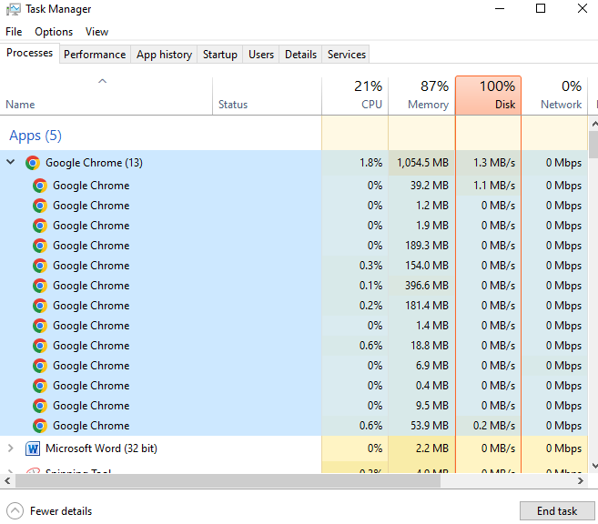

Task Manger
Thread
Mutiprocees we can see in the task manager
One procees we can see multithrad

Slide 5
Threads vs Processes
Feature | Thread | Process
Memory | Shares memory with other threads | Has its own memory
Creation time | Faster | Slower
Communication | Easier (shared memory) | Complex (IPC /Inter-Process Communication /mechanisms needed)
Overhead | Low | High
Benefits of Multithreading
Improved performance on multi-core systems.
Efficient resource sharing within the same process.
Better responsiveness in applications (e.g., UI apps).
Simplified program structure for handling multiple tasks (e.g., background tasks).

Slide 6
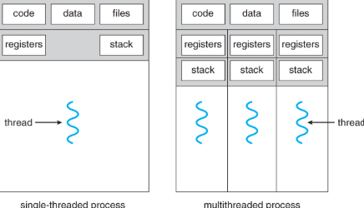
Thread
A thread is absic unit of CPU utilizaton
It Comprise
A Thread ID
A Programer Counter
A Register
A Stack
It sheras with other threads belonging to the same process its code section,data section, and other opertaing-system resourses such as pen files and signal
Single thread Process
Mult-ithread
Process
To see multi-traead install Process thread view application

Slide 7
Thread In Java
packageThreadExample;
classA {
publicvoidshow() {
for (inti=0; i<=10; i++) {
System.out.println("Hi");
} } }
classB {
publicvoidshow() {
for (inti=0; i<=10; i++){
System.out.println("Hello");
}}
}
classABMain {
publicstaticvoidmain(String[] args) {
Aa=newA();
Bb=newB();
a.show();
b.show();
} }
Example Let us take Normal object to understand thread
Output
Two Classes with a show() Method
We have two classes, A and B, both with a show() method.
The A class prints "Hi" multiple times; B prints "Hello".
Hi
Hi
Hi
Hi
Hi
Hi
Hi
Hi
Hi
Hi
Hi
Hello
Hello
Hello
Hello
Hello
Hello
Hello
Hello
Hello
Hello
Hello
This executes both methods sequentially (not in parallel).
JVM starts execution from main() and processes one line at a time.
First, it creates obj1, then obj2, and finally executes their show() methods in order.
When called sequentially (obj1.show() → obj2.show()), they execute one after another.
Threads enable parallel execution of methods.
Normal object execution is sequential by default.
To run two methods simultaneously, you must use multiple threads.

Slide 8
To achieve parallel execution,
we need to run these methods in separate threads
Converting Classes to Threads
Enable parallel execution, we make the classes threads by extending Thread:
Syntax class A extends Thread { ... }
class B extends Thread { ... }
class A extendsThread {
publicvoid run() { // print "Hi"
}
}
class B extendsThread {
public void run() {// print "Hello"
}
}
Threads allow concurrent execution.
Starting Threads:
Automatically calls the run() method (must override it).
Instead of calling show(), we invoke start(), which:
Creates a new thread.
start() activate run() behind the scenes
Analogies (e.g., "race starter") for easier understanding.
start() → run() is the thread lifecycle.
obj1.start(); // Runs A's show in a new thread
obj2.start(); // Runs B's show in another thread

Slide 9
Thread Scheduling & Parallel Execution
OS Scheduler decides thread execution order.
Multi-core CPUs enable true parallelism (e.g., 4 cores = 4 threads at once).
Example Output (Interleaved):
Hi
Hello
Hi
Hello
Output Behavior and Thread Scheduling
You might not see interleaved output initially (like Hi Hello Hi Hello...) because:
The CPU is fast.
Threads may still complete sequentially depending on timing.
To Observe True Parallel Executio
For large loops (e.g., 100 iterations), interleaving becomes visible.
You will start seeing interleaved outputs like:

Slide 10
Thread Execution Example
Output
Hi
Hello
Hello
Hello
Hello
Hello
Hello
Hello
Hi
Hi
Hello
Hello
Hello
Hi
Hello
Hello
Hello
Hello
Hello
Hello
Hello
Hi
Hi
Hi
Hi
Hi
Hi
Hi
Hi
Hi
.
.
.
packageThreadExample;
// This program demonstrates the use of threads in Java by creating two classes that extend Thread.
// Each class has a run method that prints a message in a loop. The main method starts both threads.
// The output will show interleaved messages from both threads.
// The program uses Thread.sleep to simulate a delay between prints.
// The classes A and B are defined to extend Thread, and each has a run method that prints a message.
// The main method creates instances of both classes and starts them, allowing them to run concurrently.
classAextendsThread {
publicvoidrun() {
for (inti=0; i<100; i++) {
System.out.println("Hi");
}}}
// Class B that extends Thread and prints "Hello"
classBextendsThread {
publicvoidrun() {
for (inti=0; i<100; i++) {
System.out.println("Hello");
}}}
// Main class
classMain {
publicstaticvoidmain(String[] args) {
Aobj1=newA(); // Thread that prints "Hi"
Bobj2=newB(); // Thread that prints "Hello"
obj1.start(); // Start thread for "Hi"
obj2.start(); // Start thread for "Hello"
}}

Slide 11
Java Multithreading: Thread Priority & Sleep
✅ 1. Executing Threads in Parallel
Threads A and B are used to print "Hi" and "Hello" respectively.
We create and start both threads using .start().
By default, threads run independently and in parallel, but output is not controlled — one may dominate.
🔁 2. Thread Scheduling Thread Priority
The JVM uses a thread scheduler, which decides the execution order.
You cannot directly control the scheduler, but you can make suggestions using:
setPriority(int value)
Values range from 1 (MIN_PRIORITY) to 10 (MAX_PRIORITY).Default is 5 (NORM_PRIORITY).
⚠️ Setting priority doesn’t guarantee order—it only suggests it.
obj1.setPriority(Thread.MAX_PRIORITY); // Hint to prioritize obj1
💤 3. Controlling Execution with Thread.sleep()
Use Thread.sleep(milliseconds) to pause a thread temporarily.
This allows other threads to get CPU time.
Adding small sleep delays in both threads helps alternate their
execution more evenly (Hi → Hello → Hi…).
Syntax:
try {
Thread.sleep(10); // 10ms delay
} catch (InterruptedExceptione) {
e.printStackTrace();
}

Slide 12
🧠 Key Threads
Concept | Description
start() | Begins a new thread, invokes run() internally.
run() | Defines the thread’s task.
sleep(ms) | Temporarily pauses the thread.
getPriority() | Returns current priority of the thread.
setPriority(n) | Suggests priority to the scheduler (1-10).
Scheduler | OS-level manager deciding which threads run when.
📌 Reminder:
Output order is not guaranteed even with priority and sleep.
Real-world thread behavior depends on CPU speed, system load, and OS scheduler.

Slide 13
Example Java Multithreading: Thread Priority & Sleep
We see optimized mutithreading
packageThreadExample;
classHiextendsThread {
publicvoidrun() {
for (inti=0; i<5; i++) {
System.out.println("Hi");
// Simulate some work with a sleep
try {Thread.sleep(10); // pause for 10ms} catch (InterruptedExceptione) {
e.printStackTrace();
}}}}
classHelloextendsThread {
publicvoidrun() {
for (inti=0; i<5; i++) {
System.out.println("Hello");
// Simulate some work with a sleep
try { Thread.sleep(10); // pause for 10ms
} catch (InterruptedExceptione) {
e.printStackTrace();
}}}}
classThreadDemo {
publicstaticvoidmain(String[] args) {
Hiobj1=newHi();
Helloobj2=newHello();
// Set priorities
obj1.setPriority(Thread.MIN_PRIORITY); // 1
obj2.setPriority(Thread.MAX_PRIORITY); // 10
System.out.println("Priority of Hi thread: "+obj1.getPriority());
System.out.println("Priority of Hello thread: "+obj2.getPriority());
// Start the threads
obj1.start();
try {Thread.sleep(2); // small delay to stagger thread start
} catch (InterruptedExceptione) {
e.printStackTrace();
}
obj2.start();}
}
Output
Hi
Hello
Hi
Hello
Hi
Hello
Hi
Hello
Hi
Hello

Slide 14
1.2. Thread lifecycle: New, Runnable, Blocked, Waiting, Terminated
Thread state
New:
Newly created thread that has not yet started the execution
Waiting CPU
start()
New
Runnable
Notify
Waiting
Runnable:
Either running or ready for execution but it’s waiting for resource allocationi.e., moving the thread the running state.
run()
Getting CPU
Sleep()
Running
Running
Running: When the thread gets the CPU, it moves from the runnable to the running state. Generally, the most common change in the state of a thread is from runnable to running and again back to runnable. the thread is using the CPU.
Task Comleted
Dead
Stop()
Blocked or Waiting:
Whenever a thread is inactive for a span of time (not permanently) then, either the thread is in the blocked state or is in the waiting state.The thread has been called by a wait event or is waiting for other resources (such as I/O).
Terminated (Dead)
The thread has completed execution or was terminated due to an exception.It cannot be restarted.

Slide 15
1.2 Thread Lifecycle in Java
A thread in Java goes through several states from creation to termination. These states are defined in the java.lang.Thread.State enum. The lifecycle consists of the following main states:
1. New :-The thread is created using the Thread class but has not started yet.
Thread t=new Thread(); // New state creation of object
2. Runnable(Ready to run)
After calling start(), the thread enters the Runnable state.
It means the thread is ready to run and waiting to be picked by the thread scheduler.
t is ready to run and waiting for CPU time.
t.start(); // Now in Runnable state
3. Running
The thread is actively executing its run() method.
A thread in the Runnable state enters Running when the CPU scheduler selects it for execution.
4. Blocked
A thread is in the Blocked state when it is waiting to acquire a lock to enter a synchronized block or method.
Only one thread can hold the lock at a time.
Once the lock is available, it moves back to Runnable.
synchronized (lock)

Slide 16
5. Waiting
A thread is in Waiting state if it is waiting indefinitely for another thread to perform a specific action (like notify).
A thread enters this state using methods like:
wait()
join() (without timeout)
LockSupport.park()
It must be explicitly notified to return to Runnable.
synchronized (lockObject) {
try {
lockObject.wait(); // Thread enters WAITING state
// Execution resumes when notify()/notifyAll() is called
} catch (InterruptedExceptione) {
Thread.currentThread().interrupt(); // Restore interrupt flag
6. Timed Waiting
Similar to Waiting, but the thread waits for a specified amount of time.
Enters this state via:
sleep(time),wait(time),join(time),Thread.join(time)
LockSupport.parkNanos() or parkUntil()
Automatically returns to Runnable after timeout.
7. Terminated (Dead)
The thread has completed execution or
was terminated due to an exception.It cannot be restarted.
System.out.println("Thread 1 Final State: "+thread1.getState()); // TERMINATED
publicvoidrun() {
System.out.println("Thread is running"); }
// After finishing run(), it's Terminated

Slide 17
Thread creation: Extending Thread class or implementing Runnable interface
Java supports multithreading by allowing the creation of threads in two primary ways:
1.By extending the Thread class
2.By implementing the Runnable interface
Each method has its purpose, and choosing between them depends on the design of your class and application needs.
🔹 1. Extending the Thread Class
✅ Pros:
Simple and straightforward
Direct access to start() and run()
❌ Cons:
Cannot extend another class due to Java's single inheritance limitat
OutPut
Running thread by extending Thread class.
// Class extending Thread
classMyThreadextendsThread {//Create a class that extends Thread
publicvoidrun() // the run() method
{System.out.println("Running thread by extending Thread class.");}}
classMyThreadMain {
publicstaticvoidmain(String[] args) {
MyThreadt1=newMyThread(); //Create an object of the class
t1.start(); // Call start() to launch a new thread } }

Slide 18
Thread creation:Implementing Runnable interface
✅ Pros:
Allows your class to extend another class (better design flexibility)
Encouraged in large-scale applications
Compatible with Lambda expressions (Java 8+)
❌ Cons:
Slightly more complex than extending Thread
packageThreadExample;
// Class implementing Runnable
classMyRunnableimplementsRunnable { //Create a class that implements Runnable
publicvoidrun() { //Override the run() method
System.out.println("Running thread by implementing Runnable.");
}
}
classMyRunnableMain {
publicstaticvoidmain(String[] args) {
Runnableobj=newMyRunnable(); //Create a Runnable object
Threadt1=newThread(obj); //Pass it to a Thread object
t1.start(); // starts a new thread//Call start() on the Thread object
}
}

Slide 19
Implements Runnable interface instead of extending Thread
packageThreadExample;
// Class implementing Runnable
classMyThreadRunnableimplementsRunnable{
//Override the run() method
publicvoidrun() {
for (inti=0; i<5; i++) {
System.out.println("Hi");
try { Thread.sleep(500); } catch (InterruptedExceptione) { }} } }
// Another class implementing Runnable
classYourThreadimplementsRunnable {
publicvoidrun() {
for (inti=0; i<5; i++) {
System.out.println("Hello");
try { Thread.sleep(500); } catch (InterruptedExceptione) { }}}}
classMyThreadRunnableMain {
publicstaticvoidmain(String[] args) {
// Create Runnable objects
MyThreadRunnableobj1=newMyThreadRunnable();
YourThreadobj2=newYourThread();
// Pass Runnable objects to Thread constructors
Threadt1=newThread(obj1);
Threadt2=newThread(obj2);
// Start the threads
t1.start();
t2.start();
} }
OutPut
Hi
Hello
Hello
Hi
Hello
Hi
Hello
Hi
Hello
Hi
🔍 What This Code Does:
Avoids the single inheritance issue
Creates two threads (t1, t2) and starts them
Uses Thread.sleep(500) for better output visualization

Slide 20
2. Thread Synchronization
2.1. Why synchronization is necessary
In a multithreaded program, multiple threads may access shared resources (e.g., variables, files, objects) simultaneously.
Without proper control, this can lead to race conditions, where the outcome depends on the sequence or timing of the threads.
2.2. Using the synchronized keyword to prevent race conditions
Java provides the synchronized keyword to control access to critical sections.
Ways to Use synchronized:
3.3. Deadlocks and how to avoid them
deadlock occurs when two or more threads are blocked forever, each waiting for the other to release a lock.
Conditions for deadlock (all must be present):
Mutual exclusion
Hold and wait
No preemption
Circular wait

Slide 21
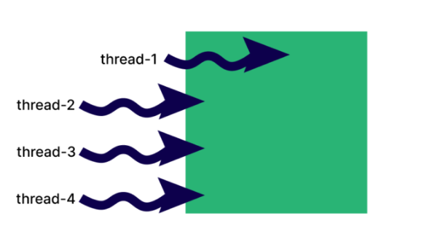
Thread Synchronization
Using method t.strat()the executionresult may be
Thread1
Thread2
Thread3
Thread4
Thread4
Thread3
Thread2
Thread1
Thread3
Thread2
Thread1
Thread4
. . . etc
Why Synchronization is Needed
Unpredictable Execution Order: Without synchronization, threads execute randomly, leading to inconsistent results.Control the order of execution for critical sections of code.
2.Resource Contention: Multiple threads accessing shared data (e.g., variables, files) can corrupt values or cause errors.
3.Thread Safety: Synchronization enforces a "lock" mechanism, ensuring only one thread executes a critical section at a time.

Slide 22
Analogy to join() and Synchronization Method:
The join() method also makes a thread wait for another to complete.
However, join() is applied at the thread level.
Synchronization allows you to control access at a finer level (specific code blocks or methods).
Avoid placing logic directly in the run() method when you want to synchronize.
When working with multiple threads, we can’t predict their execution order.
That’s where thread synchronization helps ensure only one thread executes a block of code at a time, preventing race conditions.

Slide 23
Three Ways to Achieve Thread Synchronization in Java
1.synchronized Keyword (Method Level):
Apply the synchronized keyword as a prefix to the method declaration.
When a thread enters a synchronized method, it acquires a lock on the object instance.
Other threads trying to access the same synchronized method of the same object will be blocked until the first thread releases the lock.
synchronized void display() { ... }
class Example {
synchronized void display(){// Synchronized method
Why Not Override run() with synchronized?
run() is inherited from Thread; adding synchronized changes its signature, breaking method overriding rules.
Solution: Place thread logic in a separate synchronized method (e.g., display()) and call it from run().

Slide 24
2.synchronized Block (Code Block Level):
Restrict synchronization to specific code blocks within a method.
Use the synchronized keyword followed by parentheses containing a reference to an object (the lock object).
synchronized(this) { // synchronized code block } or
synchronized(someObject) { // synchronized code block }
This allows you to synchronize only a specific portion of a method.
All threads trying to enter this synchronized block on the same lock object will be blocked.
void display() {
// Non-critical code
synchronized(this) { // Locks current object
// Critical section
}
}

Slide 25
3.synchronized static (Static Method Level):
Apply the synchronized static keywords as a prefix to a static method declaration.
public static synchronized void myStaticMethod() { // synchronized code }
Static synchronized methods acquire a class-level lock (the Class object itself), not an instance lock.
All threads trying to access any synchronized static method of the same class will be blocked.
Used when you want to lock at the class level, not instance level.
publicstaticsynchronizedvoidstaticDisplay() {
// critical section
}

Slide 26
1.This is a simple Example without synchronized and Sycronied keyword.
Output
Thread 3 0
Thread 4 0
Thread 2 0
Thread 1 0
Thread 2 1
Thread 1 1
Thread 4 1
Thread 3 1
Thread 2 2
Thread 3 2
Thread 4 2
Thread 1 2
Thread 2 3
Thread 3 3
Thread 4 3
Thread 1 3
Thread 2 4
Thread 3 4
Thread 4 4
Thread 1 4
package Synchronized;
publicclassExample {
voiddisplay() {
Threadt=Thread.currentThread();// get the current thread
for (inti=0; i<5; i++) {
System.out.println(t.getName() +" "+i);// print the thread name and the value of i
try {
Thread.sleep(1000); // sleep for 1 second
} catch (InterruptedExceptione) {
e.printStackTrace();} }}}
class TextendsThread {
Examplee;//
T(Examplee)
{
this.e=e;} // assign the Example object to the instance variable
publicvoidrun() {// run method of the thread
// This method is called when the thread is started.
e.display(); // call the display method of Example class}}

Slide 27
This is a simple Example without synchronized and Sycronied keyword.....
classExampleMain {
publicstaticvoidmain(String[] args) {
Exampleex=newExample(); // create an instance of Example class
Tt1=newT(ex); // create a new thread t1
Tt2=newT(ex); // create a new thread t2
Tt3=newT(ex); // create a new thread t3
Tt4=newT(ex); // create a new thread t4
t1.setName("Thread 1"); // set the name of thread t1
t2.setName("Thread 2"); // set the name of thread t2
t3.setName("Thread 3"); // set the name of thread t3
t4.setName("Thread 4"); // set the name of thread t4
t1.start(); // start the thread t1
t2.start(); // start the thread t2
t3.start(); // start the thread t3
t4.start(); // start the thread t4
}
}
Output
Thread 1 0
Thread 1 1
Thread 1 2
Thread 1 3
Thread 1 4
Thread 4 0
Thread 4 1
Thead 4 2
Thread 4 3
Thread 4 4T
Thread 3 0
Thread 3 1
Thread 3 2
Thread 3 3
Thread 3 4
Thread 2 0
Thread 2 1
Thread 2 2
Thread 2 3
Thread 2 4
If we add synchronized class in display method
Example {
synchronized void display() { we get resullt

Slide 28
2.synchronized Block (Code Block Level):
Take the above example then
publicclassExample {
voiddisplay() {
// This is a synchronized method.
// It can be called by only one thread at a time.
// The synchronized keyword is used to lock an object for any shared resource.
Threadt=Thread.currentThread();// get the current thread
synchronized(this){
for (inti=0; i<5; i++) {
System.out.println(t.getName() +" "+i);// print the thread name and the value of i
try {
Thread.sleep(1000); // sleep for 1 second
} catch (InterruptedExceptione) {
e.printStackTrace();
}
}
}
}
}
Output
Thread 1 0
Thread 1 1
Thread 1 2
Thread 1 3
Thread 1 4
Thread 4 0
Thread 4 1
Thread 4 2
Thread 4 3
Thread 4 4T
Thread 3 0
Thread 3 1
Thread 3 2
Thread 3 3
Thread 3 4
Thread 2 0
Thread 2 1
Thread 2 2
Thread 2 3
Thread 2 4
synchronized
Block

Slide 29
3.synchronized static (Static Method Level):
publicclassExample {
synchronized static void display() {
Threadt=Thread.currentThread();// get the current thread
for (inti=0; i<5; i++) {
System.out.println(t.getName() +" "+i);// print the thread name and the value of i
try {
Thread.sleep(1000); // sleep for 1 second
} catch (InterruptedExceptione) {
e.printStackTrace();}}}}
class TextendsThread {
Examplee;//
public void run() {// run method of the thread
Example.display(); // call using class name the display method of Example class
classExampleMain {
publicstaticvoidmain(String[] args) {
//Exampleex=newExample(); // not needed object on static
Tt1=newT(); // create a new thread t1
Tt2=newT(); // create a new thread t2
Tt3=newT(); // create a new thread t3
Tt4=newT(); // create a new thread t4
t1.start(); // start the thread t1
t2.start(); // start the thread t2
t3.start(); // start the thread t3
t4.start(); // start the thread t4
}

Slide 30
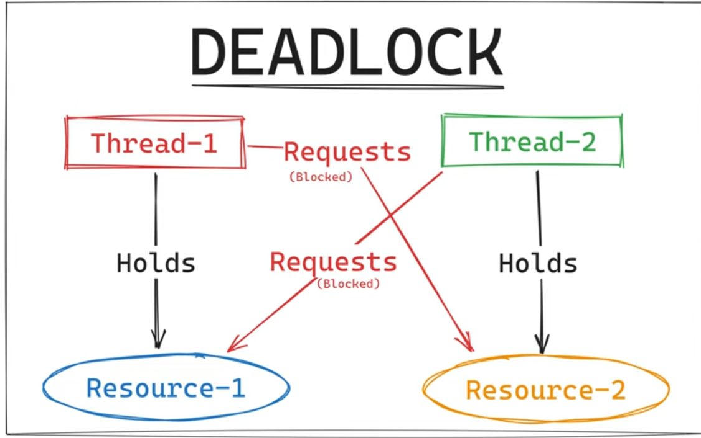
2.3 Deadlocks and how to avoid them(Reading assignmnet)
1. What is a Deadlock?
Definition: A deadlock occurs when two or more threads are blocked indefinitely, each waiting for a resource held by the other.
Visualization:
Thread 1: Holds Resource1, requests Resource2.
Thread 2: Holds Resource2, requests Resource1.
Result: Both threads wait forever → deadlock.

Slide 31
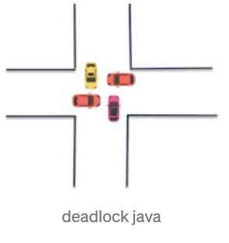
Real-World Analogy Deadlock
Analogy:Four people trying to pass in a narrow hallway, both block each other and refuse to step back.
Deadlock in java is a programming situation where two or more threads are blocked forever.
Java deadlock situation arises with at least two threads and two or more resources.
Necessary Conditions for Deadlock
1. Mutual Exclusion – Resources are held exclusively
2. Hold and Wait – Threads hold one resource and wait for another
3. No Preemption – Resources cannot be forcibly removed
4. Circular Wait – A cycle of threads waiting for resources
Notes:
These four conditions must be present simultaneously. Eliminating any one of them can prevent deadlocks.

Slide 32
Detecting Deadlocks
• Symptoms:
o Program freezes( (no progress, no CPU usage)
o Threads stuck in BLOCKED state
• Tools:
o Thread dumps (e.g., jstack)
o Java VisualVM or other profilers
Avoiding Deadlocks
Strategy 1: Lock Ordering (Fixed Order Acquisition)
Strategy 2: try-Lock Timeout (Try-Lock Mechanism)
Strategy 3:`Deadlock Detection & Recovery
Strategy 4:`Avoid Nested Locks
Strategy 5:`Use Higher-Level Concurrency Utilities

Slide 33
Avoiding Deadlocks ...
1. Lock Ordering (Fixed Order Acquisition)
What? Always acquire locks in a predefined global order (e.g., always lock A before B).
Why? Prevents circular waits (a core condition for deadlocks).
When to Use? When multiple locks must be held simultaneously.
Trade-off: May reduce parallelism if locks are overly sequential.
synchronized(lockA) { // All threads acquire lockA first
synchronized(lockB) { // Then lockB
// Critical section
}}
2. Lock Timeout (Try-Lock Mechanism)
What? Use tryLock(timeout) to abandon waiting if a lock isn’t acquired in time.
Why? Avoids indefinite blocking (threads release locks and retry/abort).
When to Use? In high-contention systems where deadlocks are rare but costly.
Trade-off: Adds complexity (retry logic) and potential livelock.
if (lock1.tryLock(1, SECONDS) { // Wait max 1 second
try {
if (lock2.tryLock(1, SECONDS)) { // Try second lock
// Critical section}
} finally { lock1.unlock(); }}

Slide 34
Avoiding Deadlocks ...
3. Deadlock Detection & Recovery
What? Actively monitor threads to detect deadlocks (e.g., via ThreadMXBean).
Why? Recovers from deadlocks instead of preventing them.
When to Use? In systems where deadlocks are unavoidable but rare.
Trade-off: Overhead from monitoring; recovery may be disruptive.
ThreadMXBeanbean=ManagementFactory.getThreadMXBean();
long[] deadlockedThreads=bean.findDeadlockedThreads(); // Detect
if (deadlockedThreads !=null) {
// Kill threads or force lock release
}
4. Avoid Nested Locks
What? Minimize locking multiple resources in nested blocks.
Why? Reduces dependency cycles between locks.
When to Use? When critical sections can be split into smaller parts.
Trade-off: May increase contention if locks are held longer.

Slide 35
Avoiding Deadlocks ...
4. Avoid Nested Locks...
// ❌ Risky (nested locks)
synchronized(lockA) {
synchronized(lockB) { ... }
}
// ✅ Safer (separate locks)
synchronized(lockA) { ... }
synchronized(lockB) { ... }
5. Use Higher-Level Concurrency Utilities
What? Replace synchronized with java.util.concurrent (e.g., ReentrantLock, Semaphore).
Why? Built-in deadlock resistance (e.g., tryLock, timeouts).
When to Use? In complex concurrent systems.
Trade-off: Steeper learning curve.
ExecutorServiceexecutor=Executors.newFixedThreadPool(2); // Avoids manual locks
ConcurrentHashMap<String, Integer> map=newConcurrentHashMap<>(); // Thread-safe

Slide 36
Summary Table
Strategy | Approach | Pros | Cons
Lock Ordering | Fixed lock sequence | Simple, guarantees no circular waits | May reduce parallelism
Lock Timeout | tryLock(timeout) | Prevents indefinite blocking | Retry logic complexity
Deadlock Detection | Monitor and recover | Handles unavoidable deadlocks | High overhead
Avoid Nested Locks | Minimize lock nesting | Reduces deadlock chances | May split logic awkwardly
Concurrency Utilities | Use java.util.concurrent | Robust, scalable | Requires API expertise

Slide 37
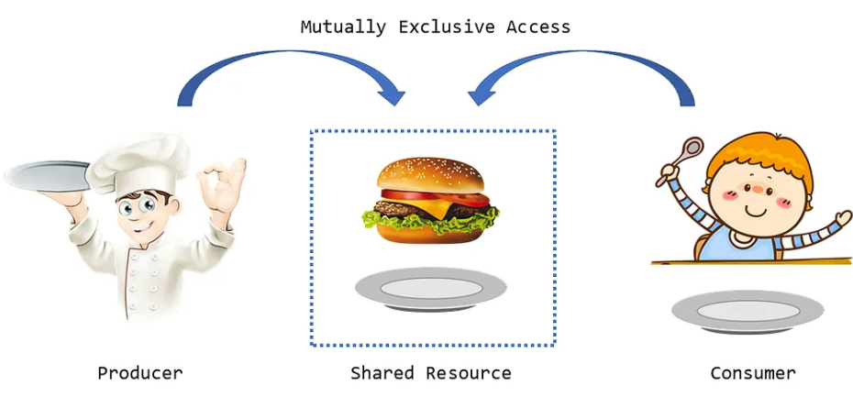
3.Producer-Consumer Problem
In this scenario, there are two types of threads: producers, which generate data and add it to a buffer, and
consumers, which remove data from the buffer.
The challenge lies in ensuring that producers do not add data to a full buffer and consumers do not remove data from an empty buffer.

Slide 38
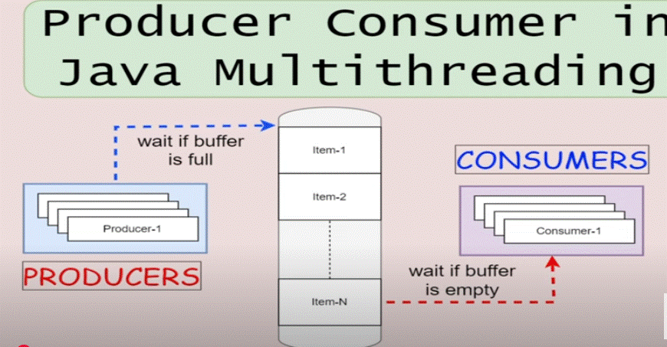
3.Producer-Consumer Problem
The Producer-Consumer Problem is a classic synchronization challenge where:
A classic Concurrency problem in operating system
Involves two Threads
Producer generates data and puts it into a shared buffer.
Consumer takes data from the buffer and processes it.

Slide 39
Challenge: Ensure thread safety when the buffer is full (producer waits) or empty (consumer waits).
Must coordinate to prevent
Buffer overflow(producer adds to a full buffer)
Buffer underflow(Consumer emoves from an empty buffer
3.1. Using wait(), notify(), and notifyAll() methods
wait(): Causes the current thread to wait until another thread calls notify() or notifyAll().
notify(): Wakes up one waiting thread (randomly chosen).
notifyAll(): Wakes up all waiting threads.
Synchronies: blocks ensure that only one yhreads accesses the critical section at a time
Bounded buffer: A fixed-sie array or queue that holds produced items

Slide 40
Thread Coomunication
Title: wait(), notify(), and notifyAll()
wait(): Releases the lock and pauses the thread until another thread calls notify().
notify()/notifyAll(): Wakes up one/all waiting threads.
Always use wait() in a loop to guard against spurious wakeups.
synchronized(object) {
// critical section
while(conditionNotMet) {
object.wait();
}
// continue processing
object.notify()
}

Slide 41
Code-Bondud Buffer
Title:Bounded Buffer Class(Shared Resource)
publicsynchronizedvoidproduce(intvalue) throws InterruptedException {
while (buffer.size() == capacity) {
System.out.println("Buffer is full. Producer is waiting...");
wait();//wait if buffer is empty
}
buffer.add(value);
System.out.println("Produced: "+value);
notifyAll(); // Notify consumer that there's data
}

Slide 42
Code-Producer & Consumer Threads
Title:Producer & Consumer Threads Implementation

Slide 43
The End Chapter 2

